Slide 1
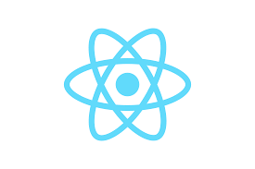
Introduction to React

Slide 2
What is React?
- Open-source JavaScript library developed by Facebook
- Used to build fast and interactive user interfaces
- Popular for building single-page applications (SPAs)
- Efficient, flexible, and component-based

Slide 3
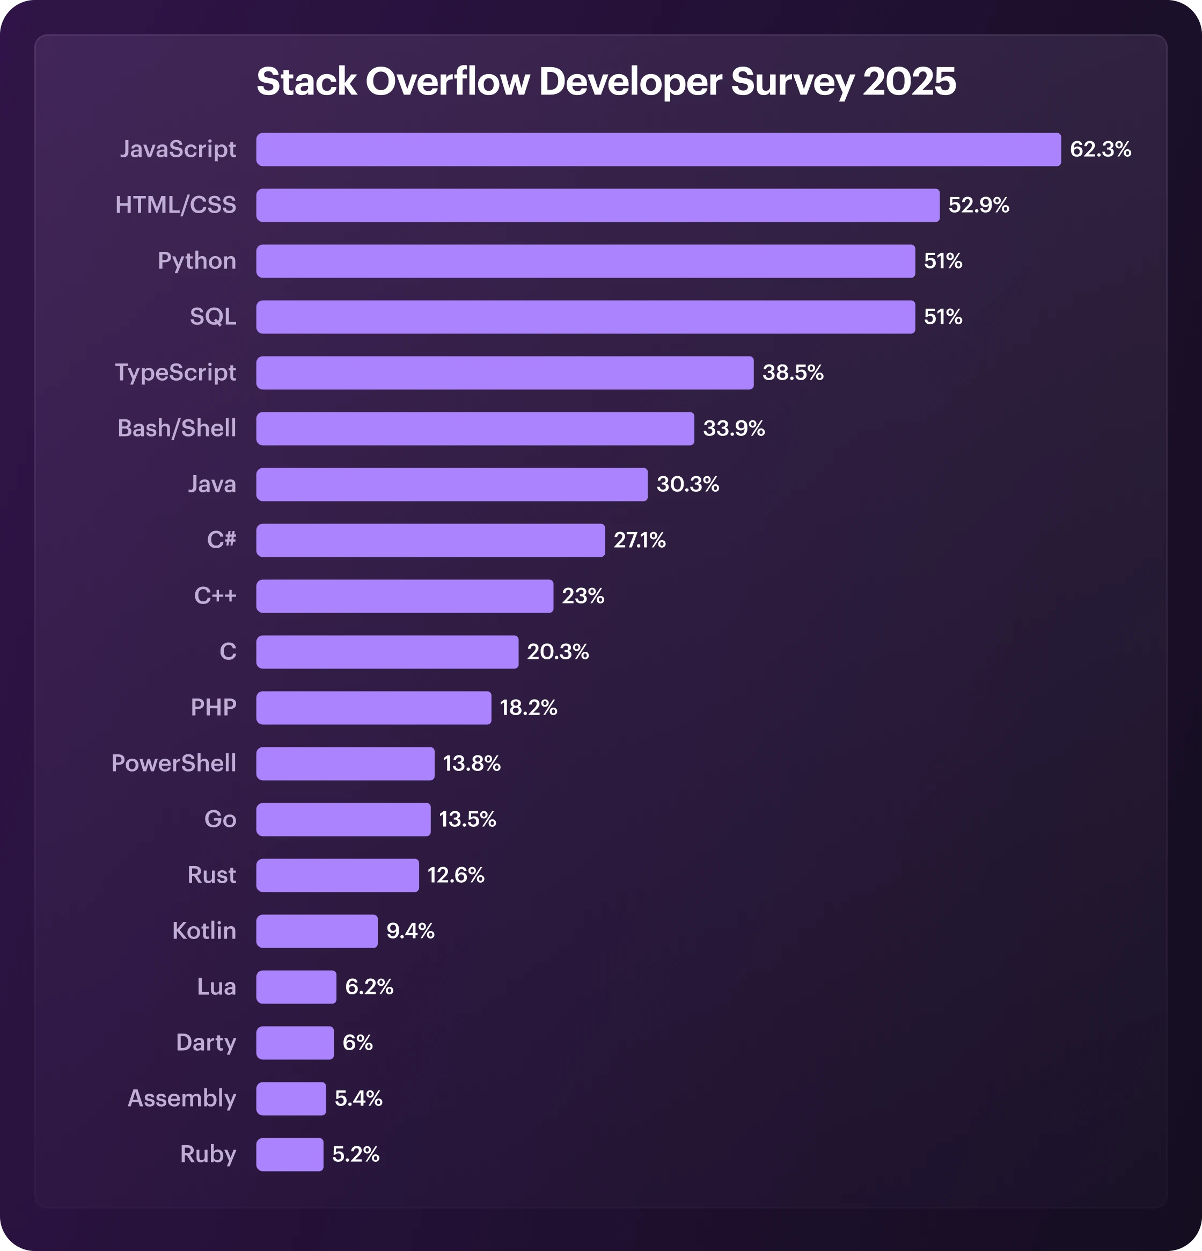
Why React?
- Reusable components for consistent UI
- Strong community and vast ecosystem
- Virtual DOM ensures fast rendering
- Backed by Meta (Facebook)

Slide 4
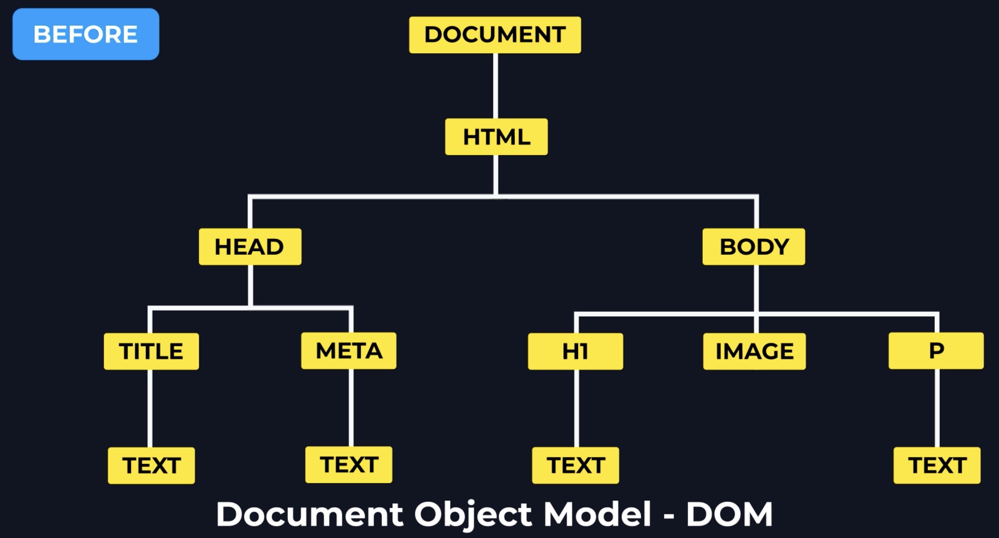
When webpage loaded on Browser

Slide 5
Component-Based Architecture
- Break UI into smaller, reusable pieces (components)
- Improves code reusability and maintainability
- Example: Navbar, Sidebar, ProductCard
App Component
Navbar
Sidebar
ProductCard

Slide 6
Declarative UI
- You describe what you want to see, not how to build it.
- React handles the DOM updates automatically
- Makes code predictable and easier to debug
State: count = 0
React renders
UI: Button shows 0

Slide 7
Single Page Applications (SPA)
- Loads a single HTML page and updates dynamically
- No full page reload on navigation
- React Router used to handle routing
- Results in a faster, smoother user experience

Slide 8
Summary
- React is a powerful library for building modern UIs
- Component-based and declarative programming style
- Ideal for building fast, scalable SPAs

Slide 9
What is the Virtual DOM?
The Virtual DOM (VDOM) is an in-memory representation of the real DOM elements generated by React components.
React uses the Virtual DOM to optimize UI rendering performance by minimizing direct DOM manipulation.
Instead of updating the real DOM directly, React updates the Virtual DOM first, then efficiently updates the real DOM based on the differences.

Slide 10
How React Uses the Virtual DOM
Initial Rendering: React creates a Virtual DOM tree representing the UI.
State Change: When a component's state changes, a new Virtual DOM tree is created.
Diffing: React compares the new Virtual DOM with the previous one to identify changes.
Reconciliation: React calculates the most efficient way to update the real DOM.
Update: Only the necessary parts of the real DOM are updated

Slide 11
Benefits of Using Virtual DOM
Performance Optimization: Reduces the number of direct DOM manipulations, leading to faster UI updates.
Efficient Updates: Only the components that have changed are re-rendered.
Improved Developer Experience: Simplifies the process of building dynamic UIs.

Slide 12
Why is Reconciliation Important?
React components re-render when state or props change.
Re-rendering the whole DOM every time would be slow.
So React:
Creates a new Virtual DOM tree.
Compares it with the previous one.
Finds differences using a smart diffing algorithm.
Updates only the changed nodes in the real DOM.
This comparison process is called reconciliation.

Slide 13
NPM vs NPX vs NVM: The Ultimate Showdown | Caret (^) & Tilde (~)
✅ npm (Node Package Manager): A tool to install, manage, and share JavaScript packages.
✅ npx: A tool to run Node packages without needing to install them globally or locally.
✅ nvm: (Node Version Manager): A tool to manage and switch between multiple Node.js versions easily.
✅ Caret (^): ^: Allows updates to all minor and patch versions, but locks the major version.
✅ Tilde (~): Allows updates to all patch versions, but locks the minor and major versions.
✅ package.json: A file that lists project dependencies and scripts, defining the project configuration.
✅ package-lock.json: A file that locks the exact versions of dependencies to ensure consistent installs.

